Slide 1
Concepts in Deep Learning: Representation Learning
Luisa Abels, Laura Hellmann
Deep Leaning by Ian Goodfellow, Yoshua Bengio, Aaron Courville in 2016

Slide 2
Table of Contents
Introduction
Transfer Learning and Domain Adaptation
Semi-Supervised Disentangling of Causal Factors
Distributed Representation
Unsupervised pretraining
Exponential Gains from Depth
Providing Clues to Discover Underlying Causes

Slide 3
Introduction

Slide 4
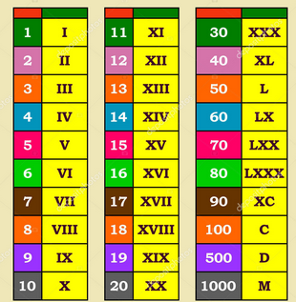
What is Representation Learning?
Everywhere in ML: with every training objective a representation is learned as a side effect
focused on finding most efficient data representation for a given task
Why is it Important?
replaced manual feature engineering
Optimized deep learning processes (e.g. faster, fewer dimensions in model)
Facilitates training with large, unlabeled datasets

Slide 5
Deep Learning and Representations
Lower layers learn simple patterns (e.g., edges in images)
Higher layers capture complex concepts (e.g., object parts)
→ each layer of a neural network refines the data representation from simple to complex
Notes:
Just a quick recap: We all know neural networks with a structure like in the picture where we have an input layer , hidden layers and an output layer. The hidden layers are our feature vectors (each node is one feature) that we want to compress into more meaningful, but abstract features. The feature vector is supposed to be the best representation od the data (features) for the intended task.

Slide 6
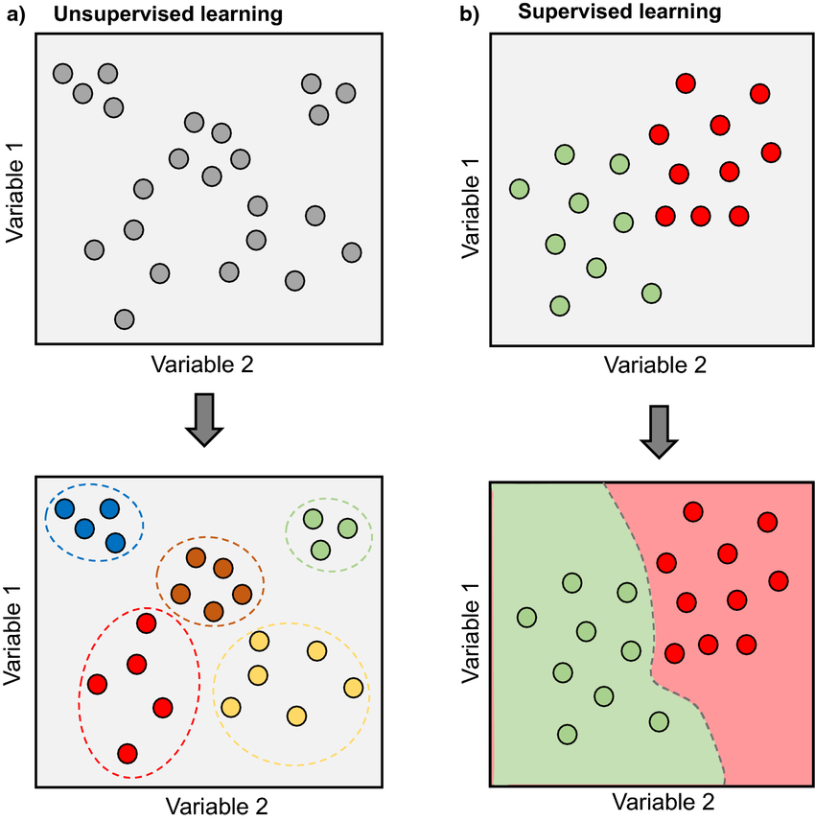
Supervised vs. Semi-Supervised vs. Unsupervised Learning
Supervised Learning:
Guide by labeled data
Semi-Supervised Learning:
Trained with unsupervised and refined with few supervised data
Unsupervised Learning:
Finds natural patterns in data

Slide 7
Unsupervised Pretraining
Historical significance:
Enabled early deep network training without labeled data
Still used in scenarios with sparse labeled datasets
Learns structuring data before applying supervised tasks
“current” problems: overfitting; too specific parameters
Notes:
Okay, now that we

Slide 8
Greedy Layer-Wise Training
Idea: Initializing DNNs by training each layer one-by-one unsupervised and fine tuning the result with supervised learning
Input (X)
train
split
Fine-Tuning
(supervised, backpropa-gation)
Autoencoder 1
Encoder 1
(X -> H1)
Hidden Layer (H1)
Discard Decoder
train
Autoencoder 1
split
Encoder 1
(X -> H1)
Hidden Layer (H2)
Discard Decoder

Slide 9
Greedy Layer-Wise Training
pro | Con
Better initialization | Time-consuming
Solved Vanishing Gradients | Outdated
Unsupervised Learning | Not fully optimal
Better representations

Slide 10
When does unsupervised Pretraining work?

Slide 11
Why does unsupervised Pretraining work?

Slide 12
Transfer Learning and Domain Adaptation

Slide 13
Transfer Learning
Definition: Involves leveraging knowledge from one task or domain (distribution P1) to improve generalization in another task or domain (distribution P2).
→ Use of unsupervised datasets possible (due to training on supervised dataset with similar/shared task)

Slide 14
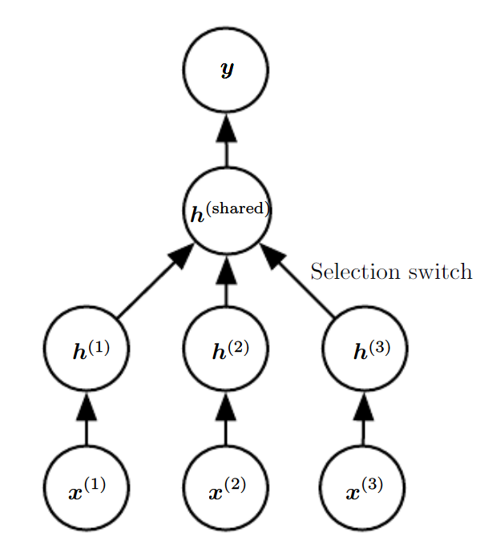
Transfer Learning
Representation shared of semantics of input, but also of output possible
E.g. Speech recognition with valid sentences in output layer, but early hidden

Slide 15
Domain Adaptation
Definition: A specific form of transfer learning where the task remains the same, but the input distribution changes. The model adapts to variations in data distribution across domains.

Slide 16
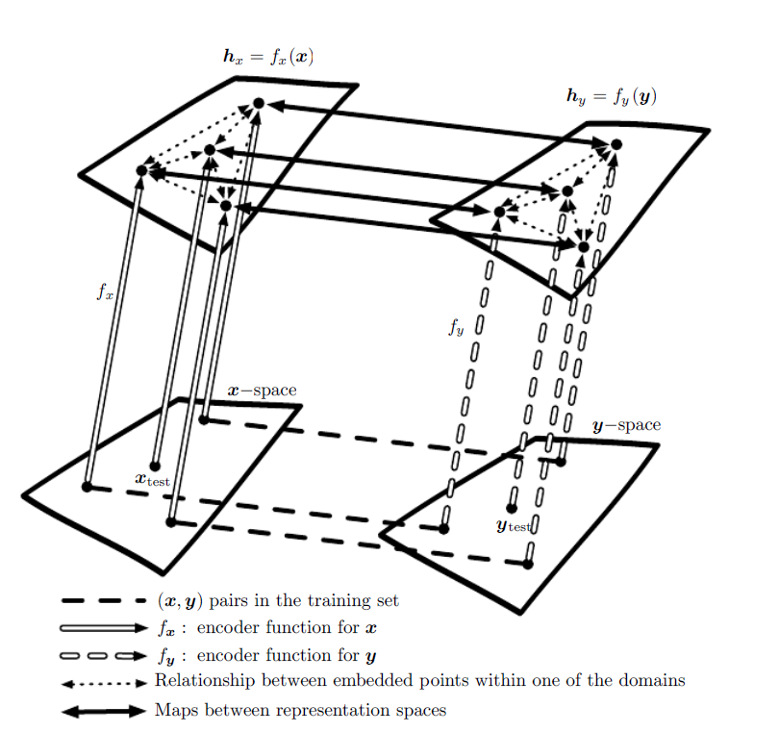
(transfer or domain?) One-shot and zero-shot learning

Slide 17
Semi-Supervised Disentangling of Causal Factors
What Makes a Representation "Good"?:
Disentangled Representations: An ideal representation is hypothesized to be one where the features correspond to distinct underlying causes of the data, making it easier to understand and manipulate the representation.
Causal Factors: A representation that captures the causal factors of observations can simplify subsequent tasks, like inferring conditions or outcomes from the data.

Slide 18
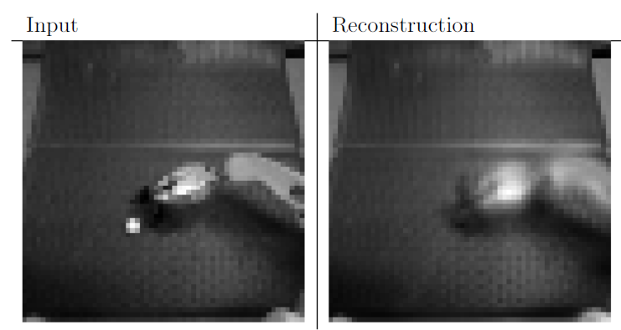

Slide 19
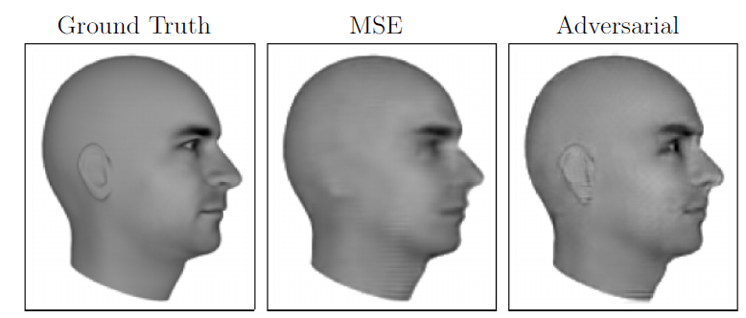
Ground Truth | Mean Squared Error (MSE) Training | Adversarial Loss Training
The correct image that the network should produce, serving as a reference for evaluating model outputs | The result of a model trained using only MSE loss Observation: Ears are not clearly represented Happens because MSE focuses on minimizing overall pixel differences, potentially ignoring subtle but important features that don't significantly affect pixel intensities | Image is generated by a model utilizing a mix of MSE and adversarial loss Observation: Ears are well-represented The adversarial component, which is typically part of Generative Adversarial Networks (GANs), helps capture finer details by learning complex patterns that MSE alone might miss

Slide 20
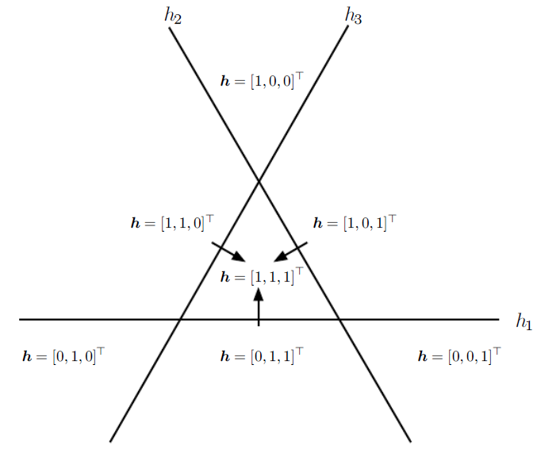
Distributed Representation
Distributed Representation:
Uses multiple binary features (e.g., h₁,h₂,h₃) to describe different regions of the input space
Each feature is activated by thresholding the output of a linear transformation → divides the space into half-planes
Input Space Partitioning:
Each feature h_{i} divides R² into two half-planes → h_{i} ⁺ and h_{i} ⁻
Overall representation space is formed by the intersection of these half-planes, giving a unique "code" for each region, e.g., [1,1,1]^{T}
Efficiency and Capacity:
With n features, the representation can distinguish O(nd) regions in R^{d} significantly more than non-distributed methods like nearest neighbors, which have linear region growth n
Despite this, a linear classifier on these representations won't assign different classes to every region due to limited capacity

Slide 21
Distributed Representation
Practical Implications:
Linearly Separable Representations: Encourages learning representations that make the classification problem easier for linear classifiers
Regularization: The capacity constraint acts as a form of regularization, focusing on essential features rather than overfitting to every possible combination
Higher-level Abstraction: Aids in learning abstract features (e.g., "person" descriptor) without needing to differentiate every small variation (e.g., "man with/without glasses")

Slide 22
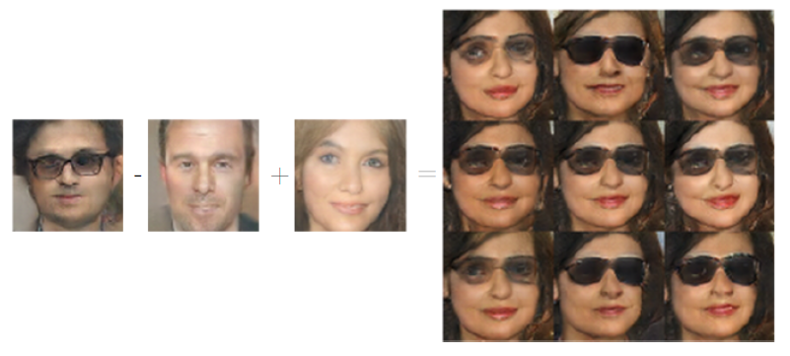
Distributed Representation
Distributed Representations:
The generative model has learned a representation space where certain high-level semantic concepts (like gender and presence of glasses) can be disentangled
Vector Arithmetic:
Start: Take the encoded representation of a "man with glasses"
Subtract: Remove the "man without glasses" representation. This effectively isolates the "glasses" component
Add: Introduce the "woman without glasses" representation, replacing the "man" component with "woman"
Result: The combination results in a "woman with glasses" representation

Slide 23
Distributed Representation
Significance:
Representation Learning: highlights the power of representation learning in capturing and manipulating high-level abstract concepts
Feature Disentanglement: ability to distinctly modify different features (gender, glasses) showcases effective disentanglement in the latent space
Applications: useful in various applications, such as style transfer, image editing, and other creative AI tasks
This approach demonstrates how abstract and human-perceivable attributes can be mathematically manipulated to achieve desired modifications in generated outputs.

Slide 24
Exponential Gains from Depth
Efficiency of Deep Networks: Deep architectures can represent functions with exponentially fewer parameters than shallow networks → improved statistical efficiency, i.e., better generalization from limited data
Deep Distributed Representations: Complex relationships between abstract factors and input data (like gender and glasses presence concerning facial pixels) require deep distributed representations composed of multiple non-linear transformations → hard for shallow networks to capture due to their limited expressiveness
Exponential Gains from Depth: The composition of many non-linearities across multiple layers enables deep networks to efficiently model high-level features which are otherwise represented only with prohibitive network sizes in shallow architectures → hierarchy of feature reuse enables them to outperform shallow counterparts for certain complex functions that require extensive nonlinear combinations.

Slide 25

Providing Clues to Discover Underlying Causes
What makes one representation better than another in the context of representation learning?
Ideal Representation:
Disentanglement of Causal Factors
Effectively separates underlying causal factors responsible
for generating the observed data

Slide 26

Providing Clues to Discover Underlying Causes
Strategies for Representation Learning
Linearity: Many algorithms assume some linear relationships between variables to extend predictions far from observed data, albeit with risks of extremity.
Multiple Explanatory Factors: Suggests that solving tasks is simplified when state information of various underlying factors is known, motivating distributed representations and semi-supervised learning.
Causal Factors: Encourages models to treat learned representations as causes of data, enhancing robustness under changing distributions or tasks.
Depth or Hierarchical Structure: Uses deep architectures to capture abstract concepts via hierarchies, indicative of using multiple processing stages to solve tasks.
Smoothness: Assumes that small changes in input lead to small changes in output, promoting generalization to nearby points.

Slide 27
Providing Clues to Discover Underlying Causes
Strategies for Representation Learning
Shared Factors Across Tasks: Advocates for shared representations across tasks for statistical strength, crucial when tasks overlap in underlying causal factors.
Manifolds: Suggests probability mass concentrates in lower-dimensional structures, with many ML algorithms attempting to model or exploit these manifolds.
Natural Clustering: Assumes data clusters or manifolds often correspond to a single class, motivating manifold learning techniques.
Temporal and Spatial Coherence: Assumes underlying factors change slowly and are easier to predict than raw data, inspiring techniques like slow feature analysis.
Sparsity: Imposes the idea that few features should be active for any given input, reducing complexity by focusing on relevant features.
Simplicity of Factor Dependencies: Good representations simplify dependencies between factors, often striving for independence or linear relationships.

Slide 28
Further Research / State of the Art

Slide 29
Conclusions

Slide 30
References

